Slide 1
CPSO with Spatially Meaningful Neighbors
Peter Wilson
Supervisor: Professor Ombuki Berman
Notes:
Good Morning everyone! Thank you for coming to hear my thesis presentation.
Today I will discuss the work I

Slide 2
Topics
Breakdown on what that means
PSO
Spatially Meaningful Neighbors
CPSO
Experiments
Experiment Setup
Results
Breakdown
Conclusion
Future Research

Slide 3
What is PSO?
Notes:
So we’ll start at the root of the idea, PSO. What is PSO?
PSO (or Particle Swarm Optimization) is a computational intelligence algorithm for optimizing continuous functions.
Like many computational intelligence algorithms, it models its actions based on behaviors found in nature. In this case, PSO attempts to replicate the flocking patterns of bird or maybe more apropos, the swarming tendencies of insects. When birds or insects are looking for food, they work as a team to find the best possible location. They take advantage of their numbers to examine a larger part of the land and communicate their findings to the group.
PSO utilizes this same approach the examine the search space of a potential problem and return the best value found in the group.

Slide 4
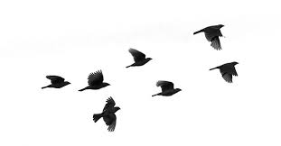
Follow The Leader
Leader
Velocity
Position
Notes:
So how does PSO implement this behavior?
Looking more into the flocking patterns of birds we can see movements similar to that of a “follow the leader” mentality. The birds will approach the bird that is ‘leading the pack’ or in other words is seemingly heading toward the best result. If another bird finds a better area, that bird then becomes the leader and the flock will follow him.
Now, looking at the individual birds in 3D space. We can note the birds movement is represented with 2 main attributes. Those being the current position the bird is at, and the velocity the bird is moving. We can use those attributes almost directly in our implementation.

Slide 5

Global Best
1
Global Best
Particle
Actual Best
Personal
Best
Solutions
Notes:
In implementing this pattern we can instead picture these birds as potential solutions on a graph. These solutions we will refer to as ‘Particles”
Similar to the birds, the particles will have a position and a velocity. The position will represent the input values we are inputting into our optimization problem.
In some cases, these will be a single value but a lot of times the optimization problems are more complex and require more inputs. The number of inputs add to the dimensionality of the problem.
This graph is a representation of a 2 dimensional problem that has 2 inputs (visibly represented on the x and y axis).
The positions need to be run through the function we are trying to optimize to find the particles ‘fitness’. Of the particles, the one in the group (or ‘swarm’) that has the best value is considered the ‘global best’.
This information gets passed to all the particles in the swarm and they will begin to head towards this global best (or ‘leader’)
As they are moving, their positions are constantly being tested against the fitness function. If a particle happens to find a better value along the way, it then becomes the leader.

Slide 6
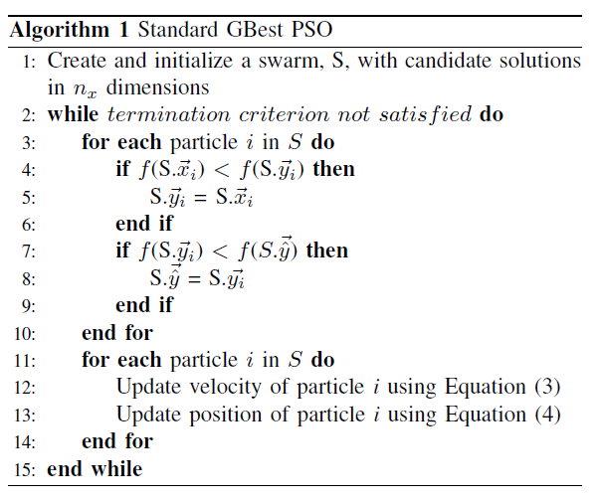
Algorithm
Notes:
So let’s get straight into the algorithm implementation of this. As you can see, there isn’t much to the main PSO algorithm.
Going line by line, we can see we first initialize the swarm and randomize the positions of the initial particles.
We then loop through cycles where, for each particle, we run it’s current value through the fitness function to determine the fitness of it’s current position.
We then compare to see if that value is better than the particle’s personal best (or best value the individual particle has found up to this point) and also see if it’s better than the overall global best (i.e. it is becoming the new leader). It is important to update these each cycle since they both will effect the future movement of the particle.
After updating these values we will then go through each particle and update their velocity and position every cycle.

Slide 7

Update Velocity
Inertia component (ω) – influence of the previous computed velocity Random, stochastic component
Cognitive component (c1) – influence of the personal best position found (pbest )
Social component (c2) – influence of the swarm collective via the global best position found (gbest)
(r1,r2) – uniform random vectors with component values between 0 and 1
Notes:
Here is the function to update the velocity of the particle.
This looks a little complicated but is much easier to understand when you break it down into it’s 3 components.
First is the inertia component. It dictates how much impact the current velocity has on the future velocity. Having a high inertia makes it more resistant to new information and will have it less quickly adjust to the movements of the global best.
Then there is the cognitive component. This dictates how much the particles personal best value effects the velocity.
The social component dictates the global best value.
Finally, it inject a bit of randomness, we also want to add some uniformly random vectors to continually change the influence with each iteration.

Slide 8

Update Position
Notes:
Now updating the position is as simple as taking that new velocity and adding it to the current position of the particle.

Slide 9
Follow The Leader
Leader
Notes:
One thing you will notice about the previous PSO algorithm is the only ‘social interaction’ between the particles in the swarm is from the leader to the rest of the swarm. ‘Non-leader’ particles have no way of sharing information between other particles.
This can lead to a more ‘naiive’ search as it is common for swarms to converge quickly to the global best without adequately searching the entire search space.

Slide 10

Neighbor Cooperation
Notes:
To combat this, a number of different techniques were tested to have particles share information. Neighborhood Topologies have been tested to allow different combinations of which particles should be able to trade with which particle

Slide 11
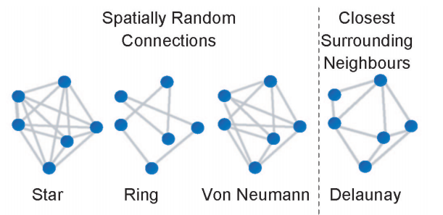
Neighborhood Topologies
Notes:
Connected particles are free to share information, but only connected particles.
The star topology connects all particles together, ring randomly connects particles in a chain (i.e. only 2 connections per particle) and von neumann allows for 4 per particle.
All of the topologies have varying results.

Slide 12
PSO Using Spatially Meaningful Neighbors
Particle Swarm Optimization with Spatially Meaningful Neighbours
James Lane, Andries Engelbrecht and James Gain
Notes:
In the paper “Particle Swarm Optimization with Spatially Meaningful Neighbours”, Lane, Engelbracht and Gain tested out a new Neighborhood topology. This topology took advantage of the location of the particles and made connections only with the closest particles.
If calculated this using the Delaunay Triangulation algorithm. This is a quick way to easily connect the particles each cycle without a significant impact on the runtime of the algorithm.

Slide 13
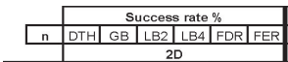
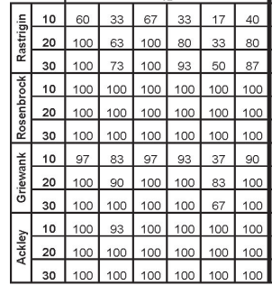
Results
Notes:
In their tests this led to equivalent or higher success rates compared to the other topologies. Using the distance of the particles allowed the Swarm to better search the search space as particles in the same general area were able to work together and more thoroughly examine the local space. For lower dimension problem, this appears to be a great tool to maximize the success of your PSO algorithm.

Slide 14
Problem
Delaunay Triangulation in 2D
O(nlogn)
Delaunay Triangulation in 4D+
O(n^{[d/2]+1})
Notes:
There is a caveat to this is the Delaunay Triangulation becomes increasingly difficult to compute in higher dimensions since the tricks used in lower dimensions no longer apply.
The algorithm is perfectly fine to use in 2, 3 and possibly 4 dimensional problems, however becomes increasingly less useful as the dimensions increase

Slide 15
PSO
Global Best
Particle
Solutions
Notes:
If we return to this graph, this PSO is optimizing to variables (x and y) and is therefore, a 2 dimensional problem. Increasing the number a variables in the problems increases the dimensionality of the problem. But as we can see, this increase of dimensionality doesn’t just effect the difficulty to calculate the Delaunay Triangulation, it also increases the difficulty of the PSO itself.
As the dimensions increase, so does the size of the search space (exponentially so). Thankfully, some research has been conducted to solve this problem for PSO that we can also take advantage of to solve our problem with Delaunay Triangulation.

Slide 16
Solution
CPSO
A Cooperative Approach to Particle Swarm Optimization
Bergh and Engelbrecht
Notes:
Fortunately, there already is a way limiting the dimensions of a problem and that is through the use of CPSO (or Cooperative PSO). Like Delaunay Triangulation, PSO too struggles with high dimension problems. To combat this, CPSO instead divides the high dimension problem into a number of smaller problems and optimizes them separately. It then merges the results at the end and returns that solution.

Slide 17

CPSO using spatially meaningful Neighbors
Notes:
This brings us to the topic of my thesis. By combining the power of Cooperative Particle Swarm Optimization with the success of spatially meaningful neighbors, we are able to divide high dimension problems into a number of 2 or 3 dimension problems to better make use of the benefits that Delaunay Triangulation gives.
This will allow us to expand this finding to a larger number of problems and ultimately make the new topology more useful.

Slide 18
CPSO Variants
Algorithm | Description
PSO | For comparison’s sake, all CPSO variants will be compared to the standard PSO algorithm to ensure either of the changes lead to a meaningful beneﬁt. All the values will be identical to their CPSO counterparts.
CPSO-S | This variant restricts each swarm to just one dimension. It solves all dimensions dependently of each other. In problems of a single dimension, the distances are easily calculated directly instead of using the Delaunay Triangulation algorithm. This is due to Delaunay Triangulation not working for problems under 2 dimensions.
CPSO-Sk | Due to Delaunay Triangulation being limited to just 2 and 3 dimensions, a k needed to be selected in which the swarm is divided into 2 or 3 dimension chunks. For the purposes of this test, swarms were divided as such that each swarm solves 2 dimensions. (k = dimensions/2)
CPSO-Rk | The Algorithm was altered to ensure all the random swarms are selected to only be between 1 and 3 dimensions to ensure the spatially signiﬁcant neighbors algorithm works. The number of swarms is set to half that of the overall dimensions to allow for an even distribution of 1 dimension and 3 dimensional swarms.
Notes:
A number of PSO and CPSO variants were tested in the application of the experiments. As a baseline, the standard PSO algorithm was run to show the difference that both the CPSO and the new topology have on execution. From there, 3 CPSO variants were tested both with the new topology and without to see the benefit of the topology on the PSO type.
The first variant is CPSO-S. This was the first proposed CPSO algorithm and is as a result the most trivial. The idea here is to divide an n-dimensional problem instead into n, 1 dimensional problems. This runs off the idea that 1 dimensional problems are incredibly trivial to optimize using PSO. In this case, for the Spatially Meaningful neighbors, Delaunay Triangulation was not required to locate close particles. Since it is 1 dimension, the algorithm wouldn’t work. Therefore, particles were instead connected to the closest particle above and below itself.
This division into 1 dimension problems has an inherent issue, though. This is because it completely ignores the dimension dependencies that exists in the original problem. By splitting it up, we are removing these connections. To ensure the connections remain consistent. CPSO-Sk and CPSO-Rk were introduced. CPSO-Sk, instead divides the swarm into k evenly sized swarms. This attempts to group dependent dimensions. Additionally, CPSO-Rk expands on that by randomly dividing the swarms into k subswarms. This means the individual subswarms are different sizes and randomly solves a different portion of the problem.
To stay true to the main idea of this combination, steps were included to ensure the swarm sizes never exceeded 3 dimensions. This means CPSO-Sk would never have a k < dimensions/3 and CPSO-Rk would never choose a random number > 3.
And CPSO-Hk (also known as Hybrid CPSO) simultaneously runs a standard PSO and swaps information between that and the CPSO

Slide 19
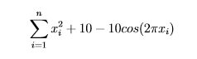
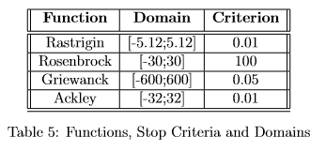
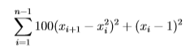
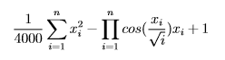
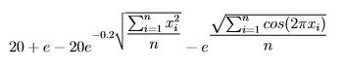
Tests
Rastrigin:
Rosenbrock:
Griewanck:
Ackley:
Notes:
In order to have a more structured test, steps were taken to match the testing benchmarks used in both the CPSO paper as well as the PSO with spatially meaningful neighbors. Thankfully, both paper used identical fitness functions and very similar testing measures.
In this case, the 4 testing functions are Rastrigin, Rosenbrock, Griewanck, and Ackley. All these functions support n-dimensions and are commonly used optimization functions. Additionally, consistent with the previous papers, these functions are clamped at their domain. This means Particles will not randomly generate outside of these pre-defined clamps as well as are restricted from moving outside. Additionally, a criterion has been set for each fitness function. This is a cutoff point at which a run is considered successful. The results are close enough to the optimal solution that we could deem the run is successful.
Again, all these values are consistent with both papers in an attempt to mirror the tests conducted previously.

Slide 20
Experimental Setup
Property | Value
Social Weight (λ) | 1.49
Cognitive Weight (ω) | 1.49
Inertial Weight (α) | starts at 1 and linearly decreases with each iteration, ultimately hitting 0 on the last iteration
Max Velocity (Vmax) | clamped to the domain of the function
Max Position (Pmax) | also clamped to the domain of the function
Particle Count | particles are evenly distributed among the swarms in the algorithm. for example, if the particle count is set to 100 and the CPSO has 10 diﬀerent swarms, each swarm will only have 10 particles to solve its particular subproblem
Notes:
And here is the parameter setup for all versions of the PSO. These are consistent across all PSO and CPSO variants. Here the Social weight and cognitive weight are defaulted to 1.49. Additionally, the Inertial weight is set to linearly decrease over the course of the run. This is set in that the inertial weight starts at 1 and decreases by the percentage of runs completed.
As mentioned previously, the max velocity and positions are clamped to the domain so the particles cannot exit these domains.
Now we have the particle count. Since the metric being used is the number of iterations required to solve the problem, it was imperative for there to be an equivalent amount of work allotted for each variant for each iteration. Having one perform 10 times the work each iteration would obviously lead to better results and therefore would make the comparison meaningless. As a result, the idea was used to divide the allotted particles amongst all swarms in the test. Each test has it’s own particle count allotment but this ensures that each iteration will have the identical number of particle evaluations regardless of the swarms. This also required for a minimum of n particles, or the number of particles equivalent to the number of dimensions. This is because CPSO-S divides the problem into 1-dimension swarms and each swarm requires at least a single particle.

Slide 21
Experiment 1: Low Dimension
6 dimension
50 runs
Robustness Tested
Percentage of Successes in the 50 runs
Average Iterations for Success

Slide 22
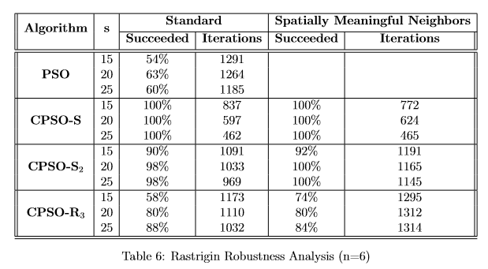
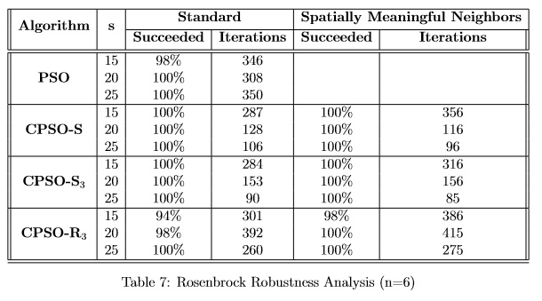
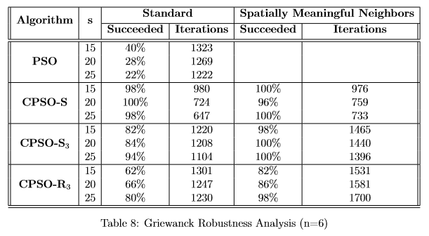
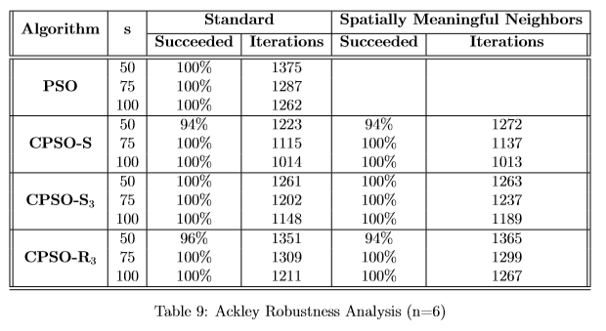
Results

Slide 23
Experiment 2: High Dimensions
20 dimension
50 runs
Particle count linearly increased with dimension size

Slide 24
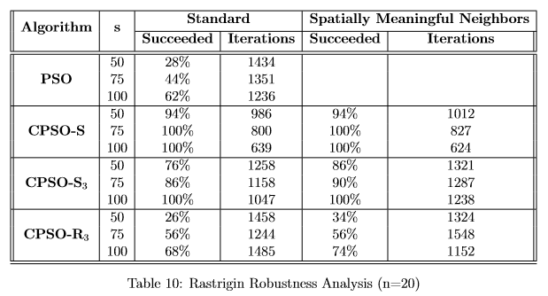
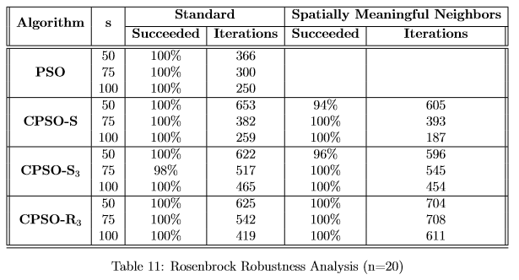
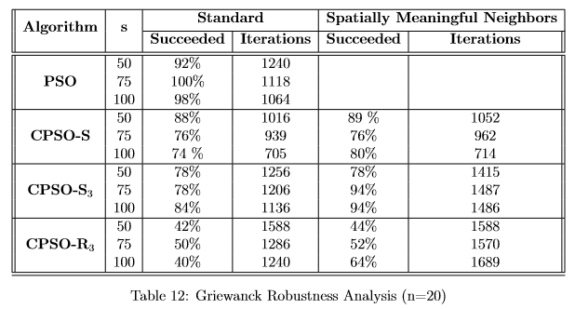
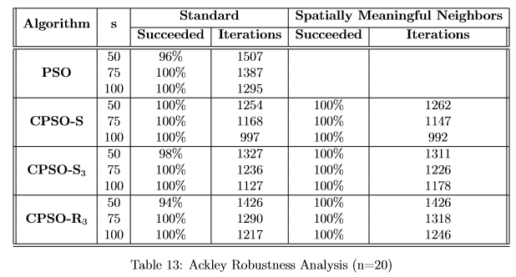
Results

Slide 25
Conclusion

Slide 26
Future Work

Slide 27
References
[1] J. Blackwell R. Kennedy. Particle swarm optimization. Swarm Itelligence, 1:33–57.
[2] Andries Engelbrecht James Lane and James Gain. Particle swarm optimization with spatially meaningful neighbours. Swarm Intelligence Symposium, September 2008.
[3] Mu˜noz Zavala Angel Eduardo. A comparison study of pso neighborhoods. EVOLVE - A Bridge between Probability, Set Oriented Numerics, and Evolutionary Computation II, 175:251–265.
[4] Gjacquenot. Delaunay circumcircles vectorial. [Online; accessed May 3 2016].
[5] Jose Gabriel Ramires-Torres Angelina Jane Reyes Medina, Gregorio Toscano Pulido. A comparative study of neighborhood topologies for particle swarm optimizers.
[6] D. T. Lee and B. J. Schachter. Two algorithms for constructing a delaunay triangulation. International Journal of Computer and Information Sciences, 9:219–242.
[7] F. Van den Bergh and A.P. Engelbrecht. A cooperative approach to particle swarm optimization. IEEE Transactions on Evolutionary Computation, page 225–239, June 2004.
[8] Alan Mackworth David Poole and Randy Goebel. Computational Intelligence: A Logical Approach. Oxford University Press, 19986.
[9] Magnus Erik Hvass Pedersen. Good parameters for particle swarm optimization.
[10] Justin Maltese. Vector-evaluated particle swarm optimization using co-operative swarms. 3F90 Thesis, 2014.
[11] Hanning Chen Tao Ku Wenping Zou, Yunlong Zhu. Clustering approach based on von neumann topology artiﬁcial bee colony algorithm.
[12] Lena Schlipf Panos Giannopoulos, Wolfgang Mulzer. Computational geometry: Polygon triangulation.
[13] M.A. Potter and K. A. de Jong. A cooperative coevolutionary approach to function optimization. The Third Parallel Problem Solving From Nature.

